Slide 1

Term Newborn Hospital Management, Discharge and Follow up
Jessie Marks DNP, ARNP

Slide 2
Learning objectives
Evaluate important aspects of history and physical exam that are critical at the immediate, discharge, and 2-3 day post nursery discharge visit to the primary health care provider
Understand normal newborn feeding patterns and requirements
Know and be able to explain newborn immunization and screening recommendations up to one month of age
Describe discharge criteria and post-d/c follow-up

Slide 3
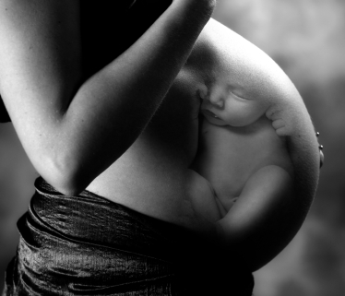
Neonatal Comprehensive Health History
Reproductive history
Family history
Social history
Current pregnancy
Intrapartum course
Delivery and stabilization
Early post-birth course
Notes:
Before a well newborn is examined, the mother's medical history should be reviewed to identify issues that could affect the care or prognosis of the newborn.
Within hospital/birth center – comprehensive history/physical necessary
2 patients, 1 history essentially
Prior pregnancies may impact this baby
Current pregnancy – any findings from US or others that might impact baby
What about L&D that might affect baby

Slide 4
Caregiver Health
Family History
Inherited conditions
CF
Clotting or bleeding disorders
Heart defects
Kidney problems
Metabolic disorders
Hearing loss
Blindness
Limb malformations
Clefts
DDH (Developmental Dysplasia of the Hip)
Age
Blood type
Chronic conditions
Hypertension
Cardiac diagnoses
Diabetes
PCOS
Infection
Mental health
Notes:
Health risks >35 years, some prenatal diagnostic testing
Blood type – if parent is O and baby A or B might lead to jaundice in baby
If Rh neg and has rh pos baby – without rhogam treatment, could be health risks for rh sensitivity
Health conditions
HTN may limit baby’s intrauterine growth
Cardiac dz – herediatry factors, amy affect preg
Diabetes – again may impact baby – if uncontrolled, LGA, risk for heart issues
PCOS – risk for lower milk production
Infection, esp during L&D, impact baby – observe for sepsis
Mental health – may impact home situation, caregiver bonding

Slide 5
Reproductive history
Gravity, parity
Gravida: Number pregnancies
Parity: Number of births
Outcomes of previous pregnancies
Spontaneous abortions, terminations, stillbirth, full-term infants, living children
Complications of previous pregnancies, labors, deliveries, birth defects, postpartum depression, lactation problems

Slide 6
Social history
Partner: involved, supportive
Other social support: family, community
Planned pregnancy?
Intended plan for birth (hospital, home, birth center)
Mental health diagnoses
Substance use disorder
Legal issues
Relinquishment for adoption
Agencies involved (teen programs, CPS)
Notes:
Home situation that impacts ability to care for baby
Support from partners, family, friends
Mental health – ability to care/cope, but also if medications/cross into milk

Slide 7
History of Current Pregnancy
Assisted reproduction
Extent of prenatal care
Pregnancy-induced hypertension (PIH)
Gestational diabetes
Infection- new onset and when
Preterm labor
Medications
Substance use- which trimester
Diagnostic testing
Ultrasound
Amniocentesis
Notes:
Dating of pregnancy: Methods
Last menstrual period (LMP)
Early prenatal ultrasound
Ballard Exam
PIH – smaller babies
Preterm labor and prolonged rupture of membranes – risk for infection
Meds that may transfer to baby
Substance use – timing important

Slide 8
Gestational Age Assessment
Ballard exam
Neuromuscular maturity
Posture
Square window
Arm recoil
Poplilteal angle
Scarf sign
Heel to ear
Notes:
Ballard exam – 2 part exam that can help judge baby’s maturity/gestational age
1st - neuromuscular maturity – grid of different movements
Don’t do on every baby typically, but if gestation not known, may be used to estimate

Slide 9
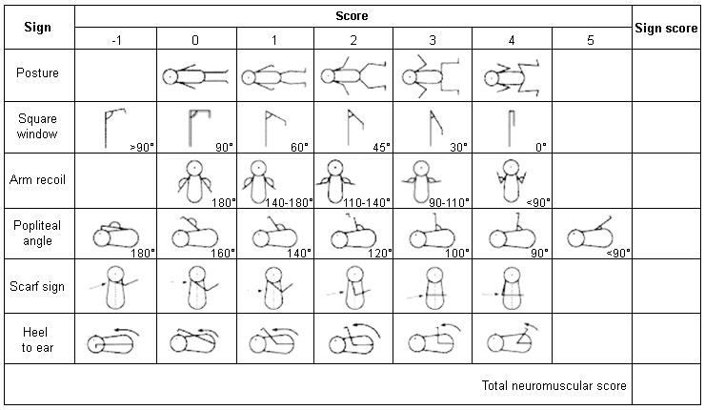
Ballard Exam: Neuromuscular

Slide 10
Gestational Age Assessment
Ballard exam
Physical maturity
Skin
Lanugo
Plantar surface
Chest- nipple area (breast)
Eye/ear
Genitals-male
Genitals-female
Notes:
2nd part of Ballard physical findings

Slide 11
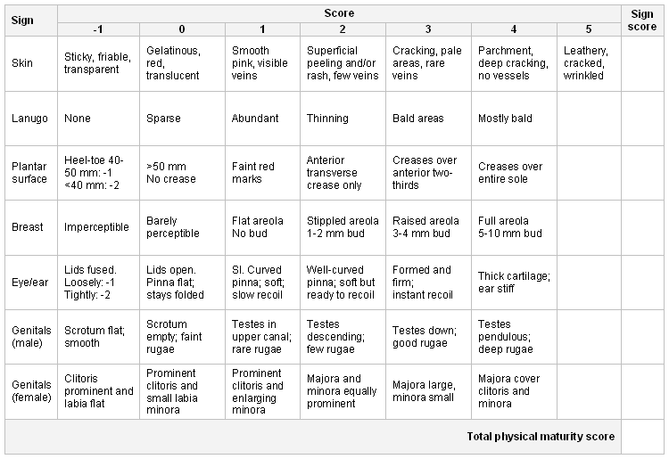
Ballard Exam: Physical Maturity

Slide 12
Intrapartum Course
Length of labor
Induction (& reason)
Duration of rupture of membranes
Intrauterine meconium
Fetal distress
Vitals (esp. fever)
Notes:
Length of labor
Induction? Rationale?
Membranes >18 hours – considered higher risk for infection, longer observation post partum
Intrauterine meconium – often at term/post term, higher risk for aspiration, Can be a sign of stress during labor as well
Fetal distress (fetal heart rate monitoring)
Fever – timing, how high etc
Fetal distress, maternal fever and other factors during intrapartum course are important to know as they will impact your management of the newborn

Slide 13
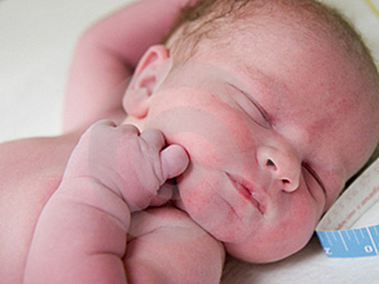
Delivery
Vaginal birth
Spontaneous or induced
Instrument delivery
Forceps, vacuum
Caesarean section
Planned
Urgent or emergent
Indications- fetal distress, failure to progress, maternal condition such as hypertension or bleeding
Notes:
In preterm infants, delayed cord clamping (at least 30 to 60 seconds) has been shown to improve the hemodynamic transition after birth. Infants have less bradycardia after birth, less hypotension, receive fewer vasoactive medications, have lower rates of intraventricular hemorrhage (IVH), and exhibit a lower mortality. In term infants, delayed cord clamping increases hemoglobin levels at birth and improves iron stores in the first few months of life. Delayed cord clamping for 30 to 60 seconds after birth is now recommended by the American College of Obstetrics and Gynecology (ACOG) for vigorous preterm and term infants.
Fogarty M, Osborn DA, Askie L, et al. Delayed vs early umbilical cord clamping for preterm infants: a systematic review and meta-analysis. Am J Obstet Gynecol. 2018;218(1):1–18.
Committee on Obstetric Practice, American College of Obstetricians and Gynecologists. Committee Opinion No. 684: delayed umbilical cord clamping after birth. Obstet Gynecol. 2017;129(1):e5–e10.

Slide 14
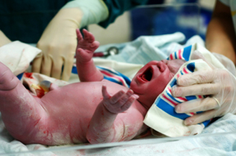
Stabilization
Standard- warm, dry, stimulate
APGAR scores
Any resuscitation efforts?
Blowby oxygen
CPAP
PPV
Chest compressions, medications
Transition issues

Slide 15
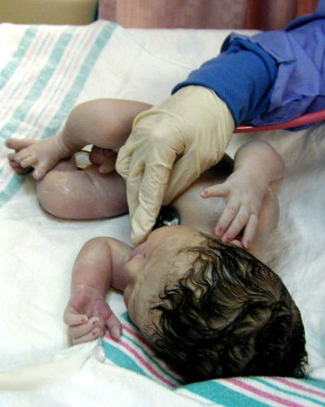
APGAR Score
Heart rate 2
Respiratory effort 2
Muscle tone 2
Reflex irritability 2
Color 2
10
Notes:
1-2 points per five areas
Almost always babies lost 1-2 points for color (rare to get a 10 pt apgar)
Usually pink up after a couple minutes
Score at 1, 5 minutes

Slide 16
Newborn Exam
Notes:
Thorough newborn exam is important as this will drive your newborn management if abnormalities are found

Slide 17
Key Times for Newborn Exams
Birth (1st few hours)
Comprehensive history and physical assessment
Hospital discharge
Weight and jaundice
Recheck admission findings
3-4 days of life
Weight and jaundice, feeding assessment
2 Weeks of life
Weight check, feeding follow up
Repeat newborn screening exams
1 month
Weight check, feeding follow up
Newborn screening exam results

Slide 18
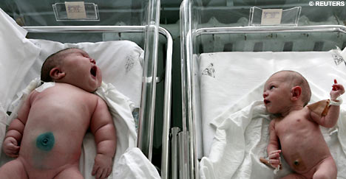
Newborn exam
General appearance
Weight, length, OFC
SGA, LGA
Tone, posture
Proportion, obvious malformations
Skin:
pink, acrocyanotic, mottled, jaundiced, bronze
State
Sleep, quiet alert, active alert, crying
Responsiveness, consolability
Notes:
Measurements in first couple hours – wt, length, OFC – graphed
Compare these in subsequent visits – weight is important indicator of caloric intake. Babies who lose >10% of birth weight – concern, intervene
Graph for small/large (above or below 10th percentile

Slide 19
Newborn exam- Skin
Numerous skin conditions encountered – majority variations on normal
Erythema toxicum
Milia
Miliaria
Transient pustular melanosis of newborn
Acne neonatorium
Nevus simplex
Primarily document and reassure
Red flags
Nevus flammeus
Jaundice
Warrant referral/follow-up

Slide 20
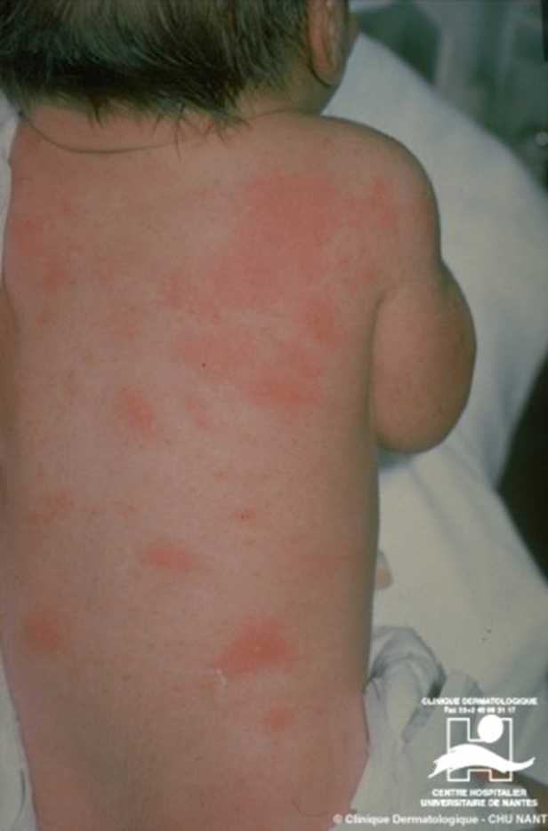
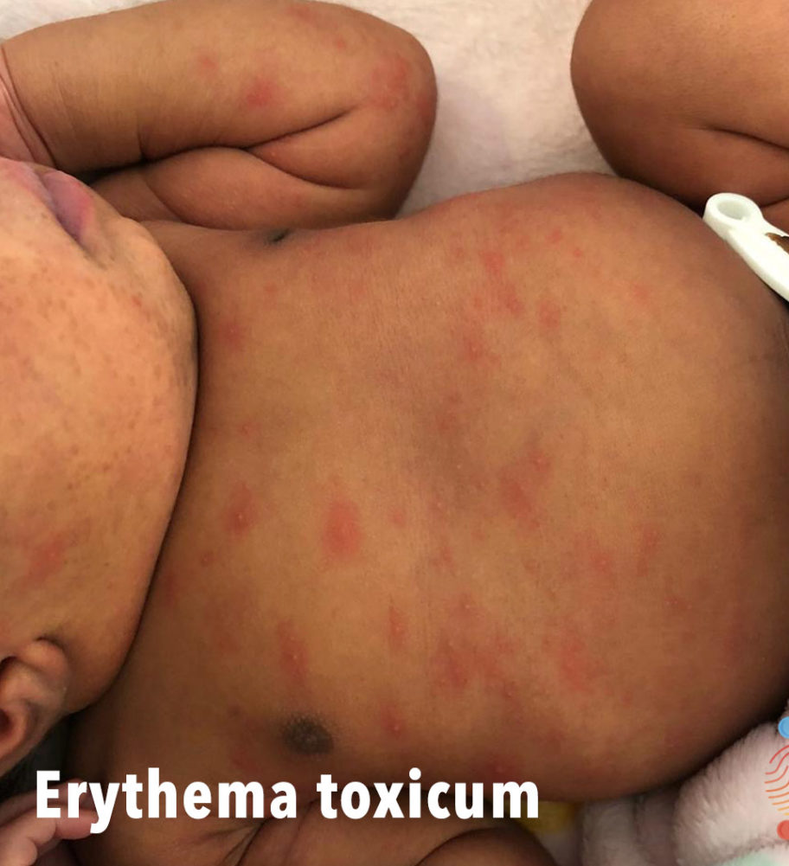
Erythema Toxicum
Notes:
Erythema toxicum occurs in 50% of newborns and is a benign, asymptomatic, self-limiting skin eruption of unknown etiology and generally presents during the first week of life.
The rash appears as combinations of macules, papules and pustules surrounded by erythema. It usually begins on the face, spreading to the chest, trunk and limbs with occasional scrotal involvement sparing palms and soles. The rash waxes and wanes, but all lesions have usually disappeared within 7-14 days. Secondary infection of the lesions is highly unusual.
No treatment is required. Provide reassurance.
https://dermnetnz.org/topics/toxic-erythema-of-the-newborn/
Parmar, T. Neonatal dermatology – the benign conditions, Don’t Forget the Bubbles, 2016. Available at:
https://doi.org/10.31440/DFTB.8168
Roques E, Ward R, Mendez MD. Erythema Toxicum. [Updated 2020 Jul 24]. In: StatPearls [Internet]. Treasure Island (FL): StatPearls Publishing; 2020 Jan-. Available from: https://www.ncbi.nlm.nih.gov/books/NBK470222/

Slide 21
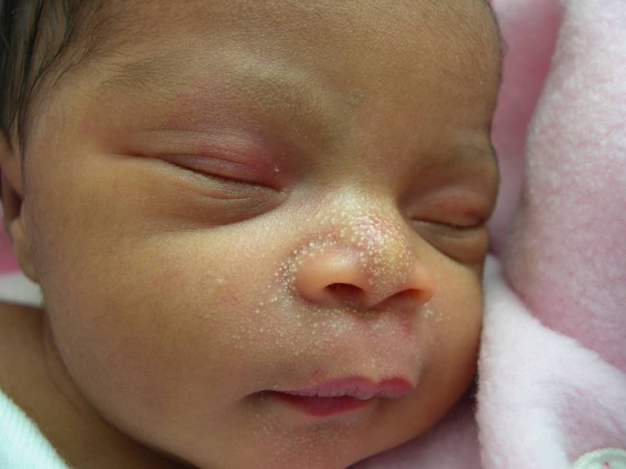
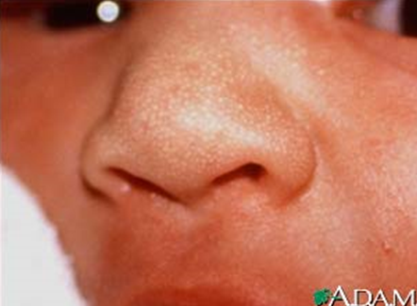
Milia
Pinpoint flat macules across nose and cheeks
Notes:
Flat white macules

Slide 22
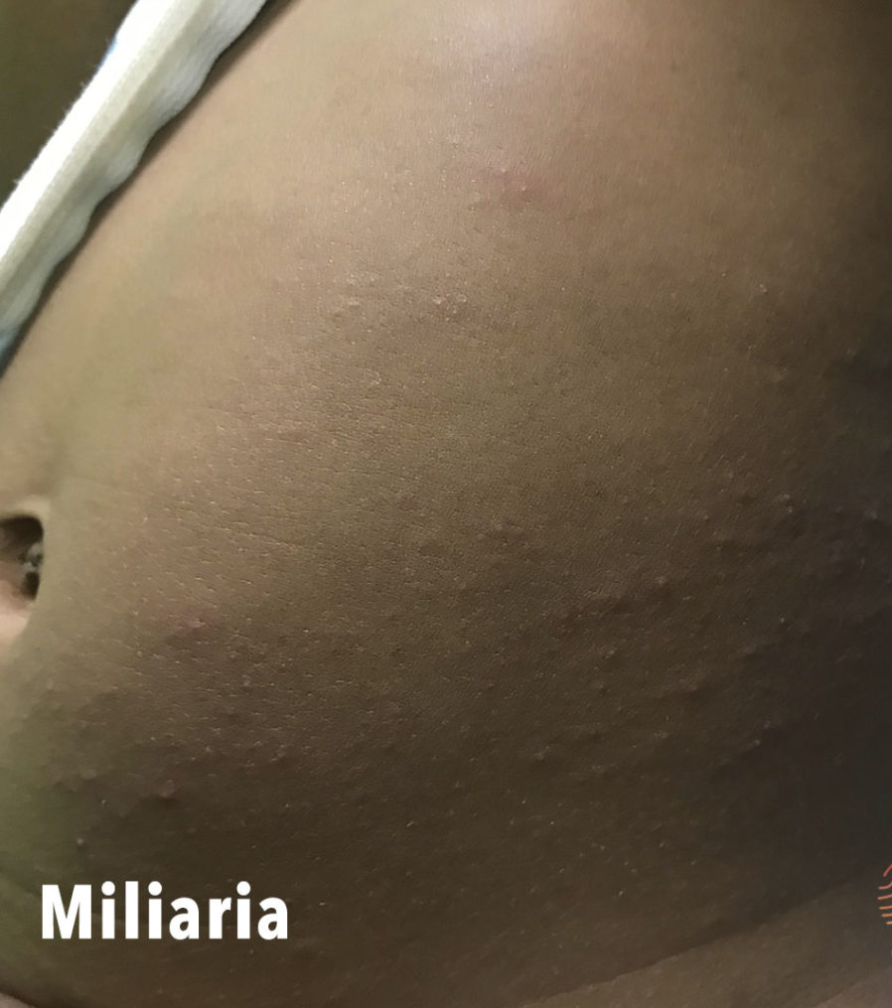
Miliaria
Notes:
Miliaria is caused by blockage and/or inflammation of eccrine sweat glands.
https://dermnetnz.org/topics/miliaria/
https://www.aafp.org/afp/2008/0101/p47.html#:~:text=Both%20milia%20and%20miliaria%20result,the%20first%20month%20of%20life.

Slide 23
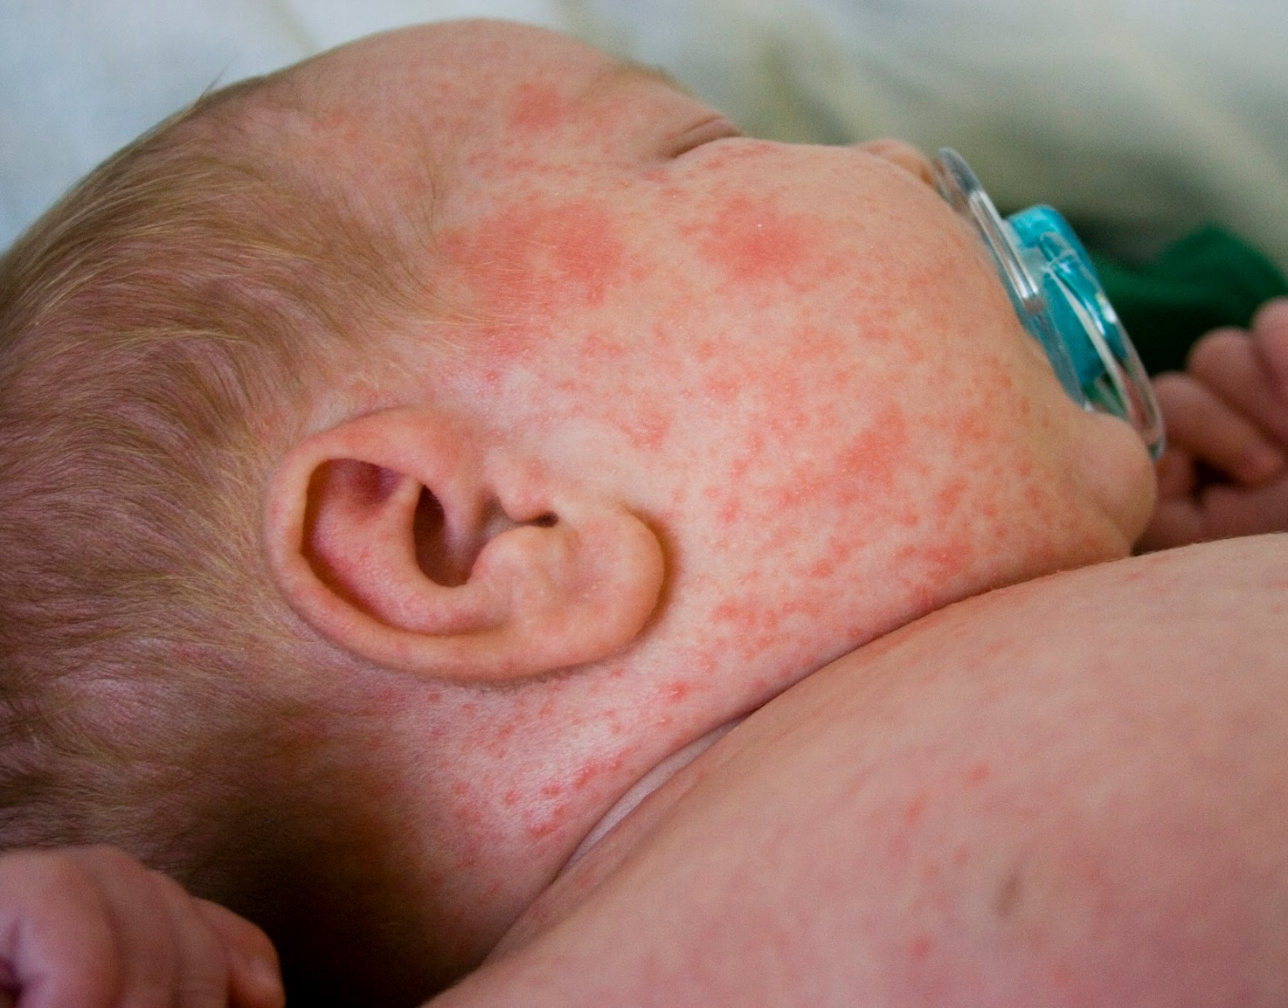
Milaria Rubra (Heat Rash or Prickly Heat)
adhb.govt.nz
Notes:
Is from the obstruction of sweat glands in deeper layer of epidermis
Milaria Rubra – discrete erythematous papules and papulovesicles
Forehead, upper trunk,
Often heat/humidity related, though can result from products (ie scented soaps/shampoos)

Slide 24
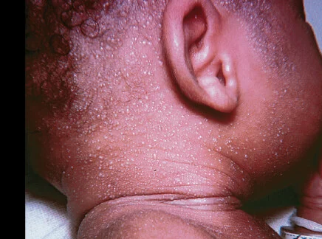
Miliaria Crystallina
Notes:
Miliara crystallina has 1-2 mm superficial blisters that easily break, without inflammation or erythema, usually seen on the head, neck and upper trunk in neonates.
It is typically due to immature sweat ducts in a neonate, can also be from hot and humid environments
https://dermnetnz.org/topics/miliaria/
https://www.aafp.org/afp/2008/0101/p47.html#:~:text=Both%20milia%20and%20miliaria%20result,the%20first%20month%20of%20life.

Slide 25
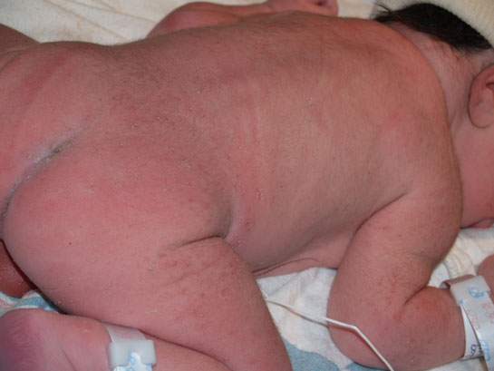
Transient Pustular Melanosis of Newborn
newborns.stanford.edu
Notes:
Transient pustular melanosis of newborn
Pustules which rupture, followed by collarette of scale, then hyperpigmented macule
May see all stages on the baby simultaneously

Slide 26
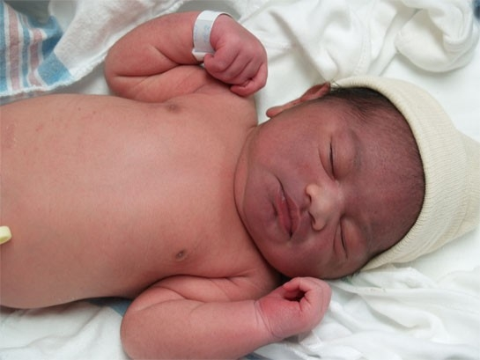
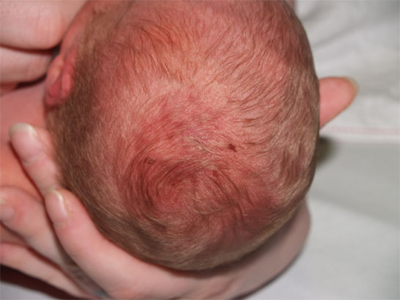
Petechiae and Bruising
Notes:
Full body petechiae is worrisome

Slide 27
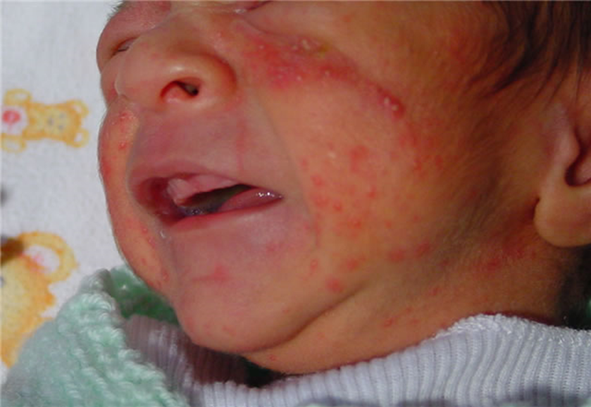
Acne Neonatorum
Notes:
Acne neonatorum
Onset three weeks, mean duration 4 months
Rarely use treatments, unscented products (to not irritate)

Slide 28
Nevus Simplex vs Flammeus
Nevus Simplex
Nevus Flammeus
“Stork bite” or “angel kiss”
Flat, pink or salmon-colored
Face, nape of neck
Spontaneous resolution on face
Port wine stain
Flat, pink, reddish blue or purple, color may deepen
Note location: associated conditions (Sturge-Weber, Klippel-Trenaunay)
Notes:
Birthmarks

Slide 29
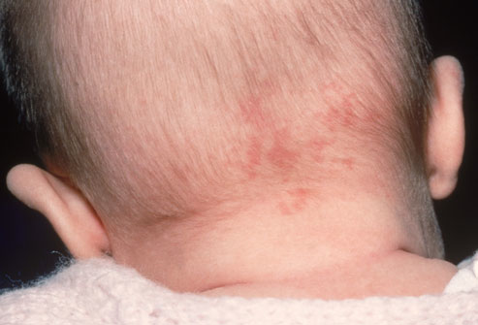
Stork Bite
Notes:
Stork bite (nevus simplex)
Very common at nape of neck, especially in fair-skinned baby

Slide 30
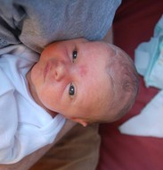
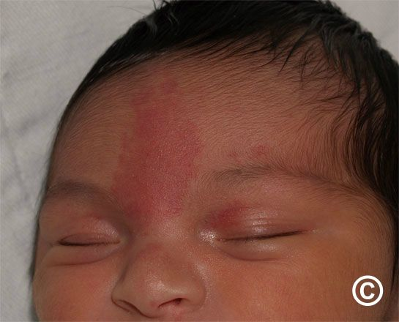
Nevus Simplex
stanford.wellsphere.com
Notes:
Very common – v-shaped lesion to forehead, eyelids, sometimes btwn nose and mouth too
When will it resolve? Usually fade over a few years

Slide 31
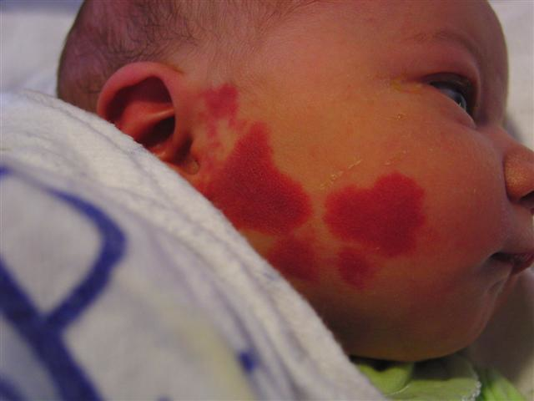
Nevus Flammeus
adhb.govt.nz
Notes:
port-wine stain
Darker, more extensive, redness may deepen vs resolve
Location can be associated with particular conditions (ex sturge webber – port wine around eye)
This finding would need referral

Slide 32
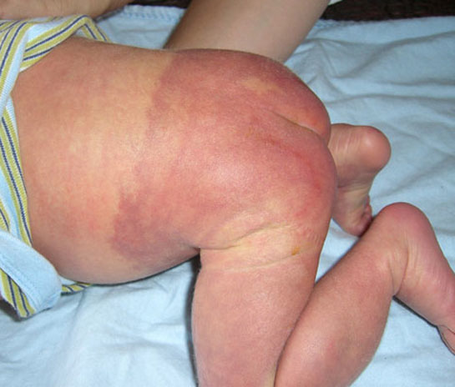
Nevus Flammeus
Notes:
Port wine stain again – sacral and legs

Slide 33
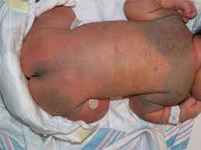
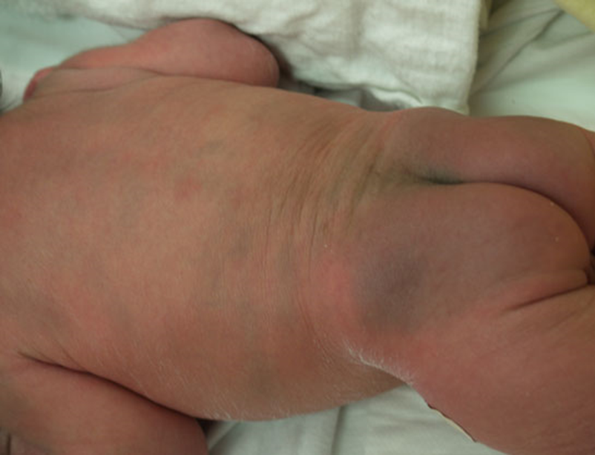
Congenital Dermal Melanocytosis (Slate grey Patch)
Notes:
Old term – mongolian spots
Most common – lumbar, sacral areas
Common – shoulders, backs of arms
Lumbar, sacral back most common; less commonly on extremities
May be mistaken for a bruise
Is important to document these on your first exam

Slide 34
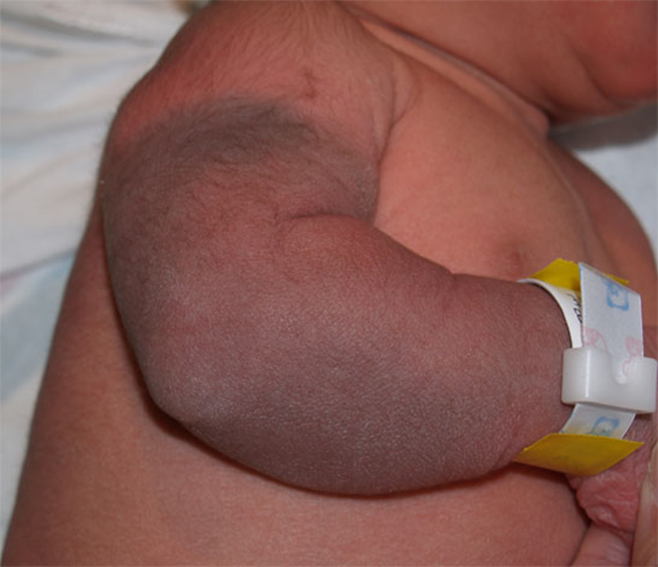
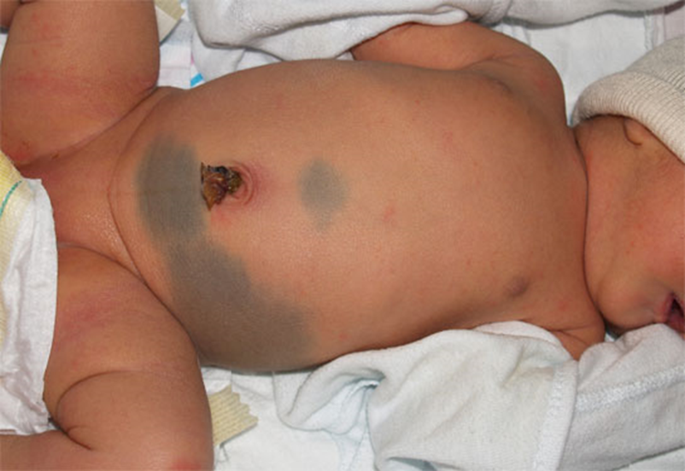
Congenital Dermal Melanocytosis (Slate grey Patch)

Slide 35
Newborn exam: HEENT
Head
Molding, shape
OFC
Normal is 33-38 cm
Fontanelles
Anterior
Posterior
Sutures
Over-riding, approximated, split
Craniosynostosis
Notes:
Head – many changes in first few hours
Head molding after birth
OFC outside of range, consider hydrocephalus or microcephaly
Fontanelles – soft spots
Intersection of coronal suture and sagittal sutures – if bulging/tense (rare), sit up and assess. If normal upright – normal, otherwise refer
Posterior fontanele very small (may not be palpable) – lamboid sutures in back
Large ridge? Overriding sutures -

Slide 36
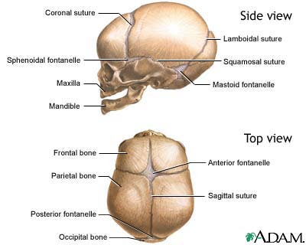
Suture Review
Metopic suture

Slide 37
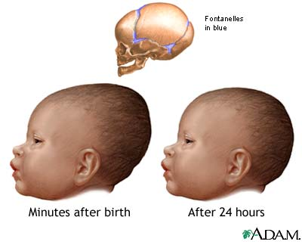
Molding

Slide 38
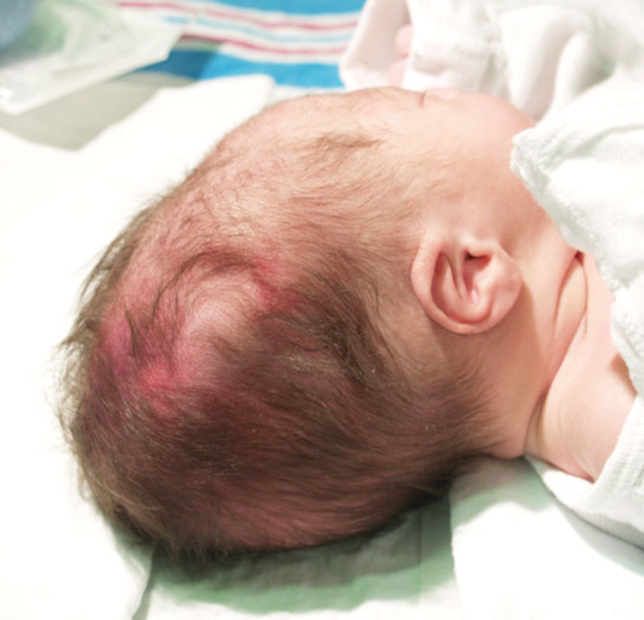
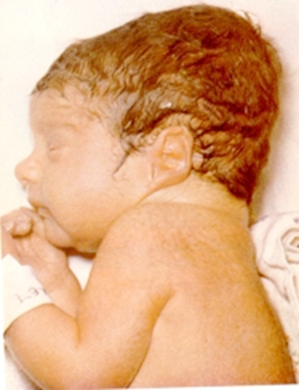
Caput Succedaneum
Newborns.stanford.edu
Notes:
Can be due to pressure prenatally or during delivery, esp. if vacuum used
Soft, puffy- like edema
Crosses sutures can move across suture lines
May be dependent, shifts with head position

Slide 39
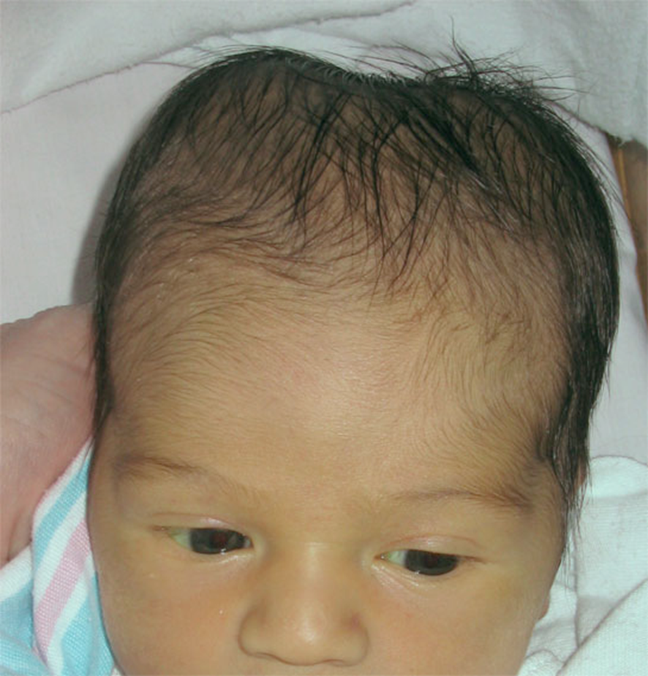
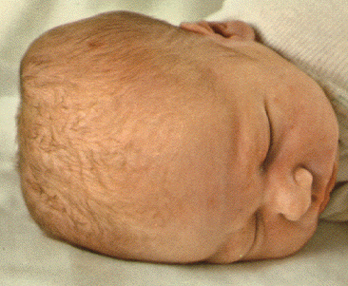

Cephalohematoma
Nursing.duq.edu
Notes:
Does not cross sutures
Resolves over weeks
May have 2 discrete cephalhematomas
More taught

Slide 40
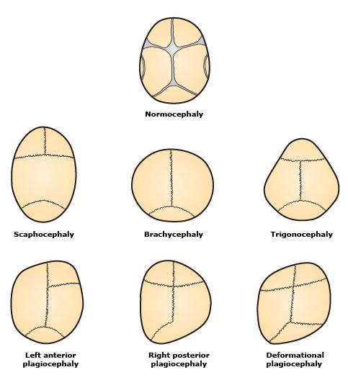
Craniosynostosis
1+ of the suture lines close prematurely
Impinge on brain growth
Malformed skull
Dx – start with PE
Referral
Imaging

Slide 41
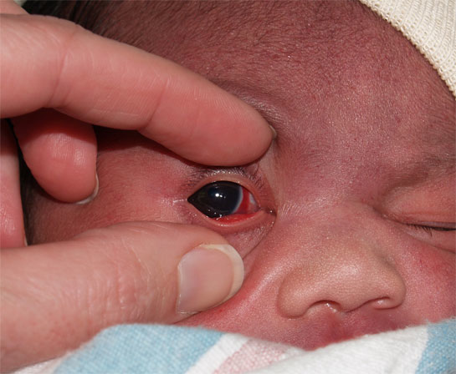
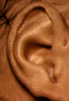
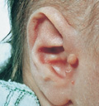
Newborn exam: HEENT
Facial symmetry
Eyes
Placement, palpebral fissures, epicanthal folds
Red reflexes, asymmetry of pupils
Subconjunctival hemorrhage (normal in first days)
Crossing (normal)
Ears
Pinnae, external canal
Preauricular tags/pits
Hearing screen
Nares
Patent
Notes:
May have some asymmetry r/t position in uterus
However – look for symmetry
Red reflex – gross exam, not detailed
Subconjunctival hemorrhage normal in first days (pressure of birth)
Normal for eyes to cross in beginning
Ear shape, EAC, pits/tags (along front of ear) – common, but can be r/t hearing or renal problems
Patent nares – check both nostrils (occlude one side at a time). Stuffiness is normal. If they cannot breathe through nostril will impact eating

Slide 42
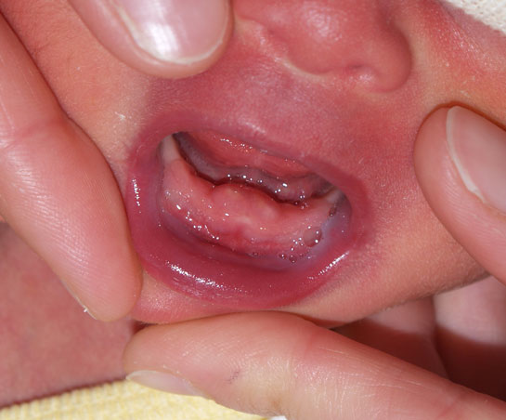
Newborn exam- HEENT
Mouth
Symmetry, esp. with cry
Palate
Normal shape variations
Cleft, unilateral, bilateral, submucous (often occult)
Lip
Cleft
Thin
Uvula
Teeth
Rooting, sucking
Notes:
Facial findings may be related to genetic syndrome, fetal alcohol…
Symmetric mouth during cry
Palate – feel with gloved finger, also look
Submucous cleft may be present – could feel but not see
Often assoc with bifid uvula (divided)
Neonatal teeth – may be present, if loose needs to be addressed due to risk of aspiration
Root/suck – check with gloved finger

Slide 43
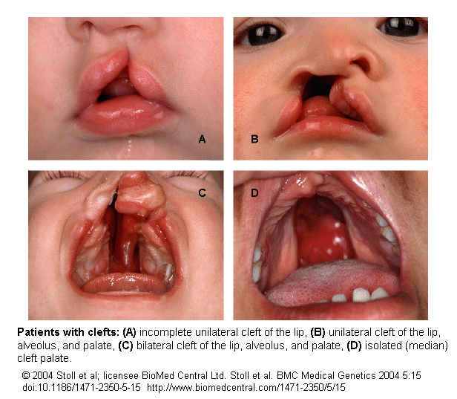
Cleft Staging
Notes:
Usually prenatally diagnosed

Slide 44
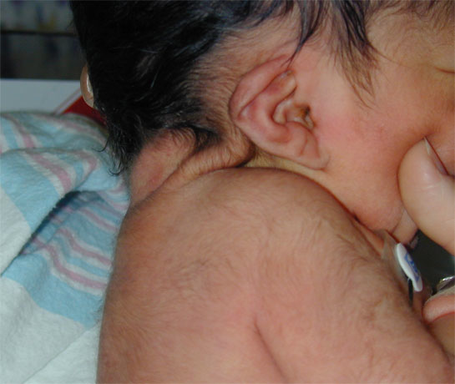
Newborn exam- HEENT
Neck
ROM
Tone
Webbing or redundant skin
Masses
Torticollis
Notes:
If can only turn in one direction – check for torticollis, may be r/t prenatal positioning,

Slide 45
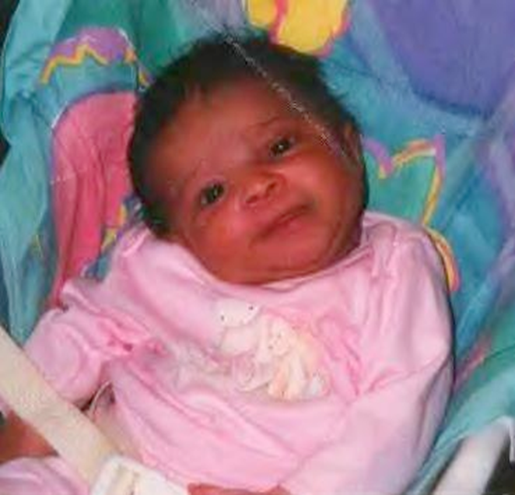
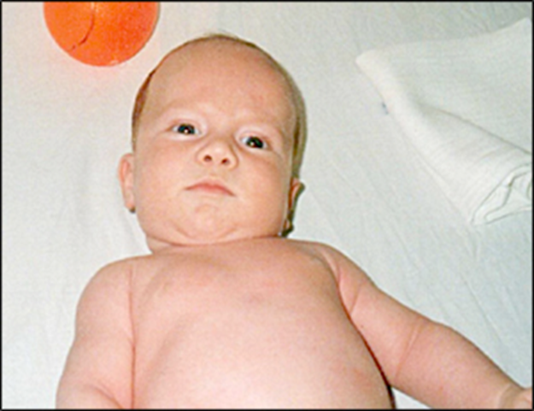
Torticollis
www.aafp.org
Torticolliskids.org
Notes:
Torticollis examples/positioning
Means twisted neck – can be congenital or acquired
If congenital – may have facial asymmetry
On exam – impacts ROM of neck, shortened/tight Sternocleidomastoid
Clinical dx
Need conservative passive/stretching exercises, environmental management (positioning objects of interest to encourage midline orientation) PT options as well

Slide 46
Newborn exam: Chest
Clavicles
Chest shape, symmetry
Nipples
Swelling, discharge
Supernumerary nipples
Notes:
Fractured clavicle at birth not uncommon
Feel them – should feel symmetric, if fracture – crepatice, clicking. Day 2+ may be swollen but less distinct. No treatment but document. Heals quickly
Chest shape/symmetry may trigger genetic eval
Nipples/discharge – transient from maternal hormones

Slide 47
Newborn exam: Cardiovascular
Heart rate, rhythm
Heart sounds: murmurs common
Femoral pulses
Color
Acrocyanosis is normal in 1st day
Notes:
Cardiac very important, extensive
Murmurs common first 24 hours, flow murmurs/PDA that resolve
Some appear in 2-3rd day (VSD)
Document type, when, where, whether increasing over days or resolving…

Slide 48
Newborn exam: Respiratory
Respiratory rate
Periodic breathing is normal
Breath sounds
Work of breathing
Grunting, nasal flaring, subcostal or intracostal retractions
Color
Circumoral cyanosis indicates distress
Notes:
May have rapid rr, TTN
After that resolved, tachypneic baby should not discharge
Periodic breathing is normal (fast, then slow, then 10-15sec apnea). REASSURE
Symmetric breath sounds, check WOB
Check nasal flaring, grunting very concerning
Circumoral cyanosis – more central, CONCERN

Slide 49
Newborn exam- Abdomen
Appearance
Nornal: soft, protruberant
Abnl: distended, tense, prune belly
Bowel tones
Palpation
Masses, liver, +/- kidney
Umbilicus
Normal: small amt erythema, small amt oozing at time of separation, slight odor
Abnormal: increasing abdominal erythema around umbilicus
Anal patency
Notes:
Usually fairly round, soft NOT distended or tight
Palpate liver/kidney – most masses not palpated, usually prenatally diagnosed
Umbilicus – shouldn’t have erythema, cord clamp may cause some redness. Gooey and slight odor during involution (about to fall off).
Anal patency – check via stool

Slide 50
Newborn exam: Male Genitalia
Penis
Hypospadius
Chordee
Circumcision care
Testicles
Maturity: increased rugae and color
Cryptorchidism, unilateral or bilateral
Hydrocele
Inguinal hernia
Notes:
Genitalia – many findings and some variations
Ballard has some detail on term vs preterm findings
Rugae in testicles – maturity
Testicles – should be able to find in scrotum or canal. If not – fu in first year

Slide 51
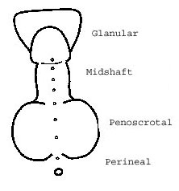
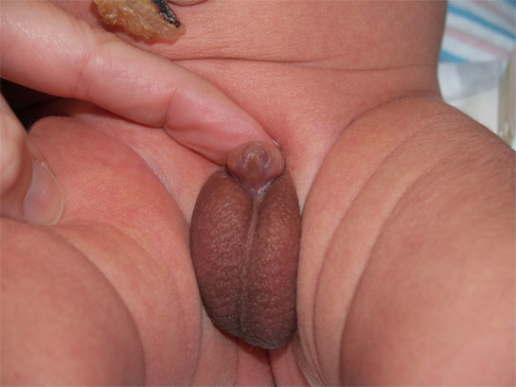
Hypospadius
newborns.stanford.edu
Notes:
Hypospadias – meatus is ventral – varying degrees, foreskin may be incomplete
Warrants documentation
Referral and consult with urology
Monitor for split urinary stream

Slide 52
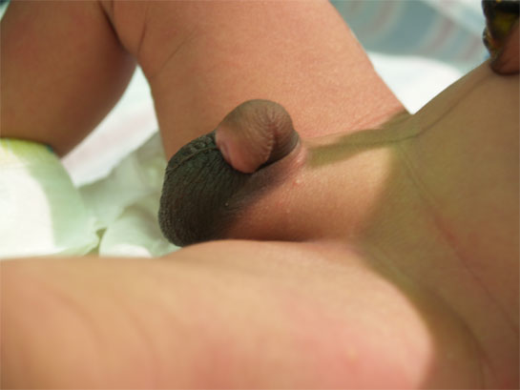
Chordee
newborns.stanford.edu
Notes:
Chordee – ventral penis – midline tissue tight
Referral to Urology

Slide 53
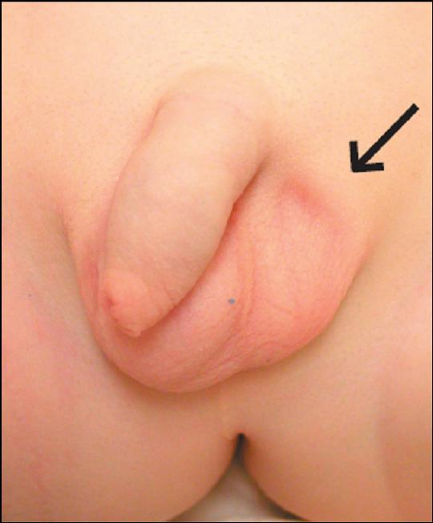
Cryptorchidism
Undescended testicle
Approx 3% male newborns
Decreases to 1% between 6-12 months of age
Document
Palpable?
Gregor Mikuz
Notes:
Undescended side – scrotum less developed
Document if palpable in inguinal canal
Referral if undescended at 1 year (but palpable)
Not palpable – consider earlier referral (6 months)
Retractile – normal testes that pull into suprascrotal position by cremasteric reflex

Slide 54
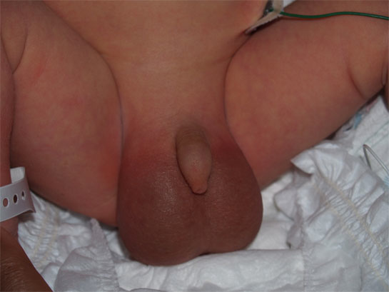
Hydrocele
newborns.stanford.edu
Notes:
Collection of peritoneal fluid btwn parietal and visceral layers of tunica vaginalis
Very common in newborns, majority resolve spontaneously (by 1st bday)
Palpate. Dx by transilluminating scrotum – demonstrates cystic fluid collection
If you illuminate – will light up with fluid, can be unilateral or bilateral
Hydrocele – transilluminates vs hernia, not as bright. Hydrocele resolves

Slide 55
Newborn exam: Female Genitalia
Discharge- mucus or blood normal
Erythema of labia is normal in first days
Ambiguous genitalia - REFER
Multidiscliplinary workup is necessary at birth
Maturity
With increasing maturity, labia majora covers labia minora and clitoris
Hymenal tags
Notes:
Normal discharge – mucous/blood r/t maternal hormones
Erythema normal ifrst days
Ambiguous genetalia – 1+ unusual finding, multidisc work up necessary

Slide 56
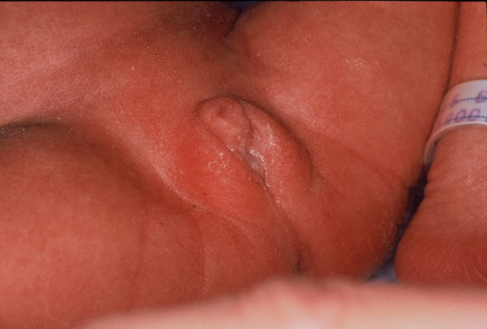
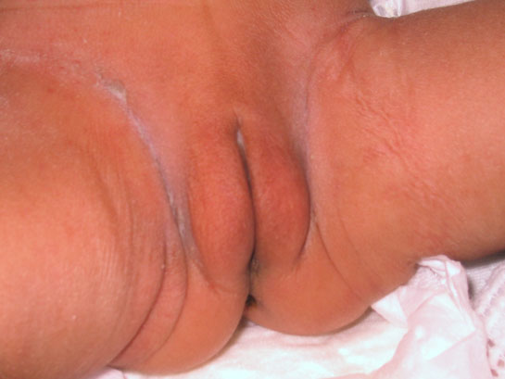
Maturity of Labia Majora
Preterm
Full Term
preterm
newborns.stanford.edu
Notes:
FT labia majora larger, less well developed in preterm baby

Slide 57
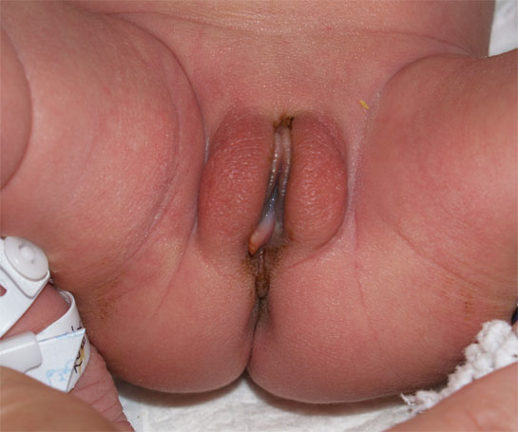
Hymenal Tag
newborns.stanford.edu
Notes:
3-13% of female newborns
Tend to resolve spontaneously
Reassure, benign
Tags – light pink, translucent, can be significant – NORMAL, usually go away

Slide 58

Newborn exam: Orthopedic
Upper extremities
Supernumerary digits- congenital remnant of digit
Syndactyly – digits fused
Polydactyly – extra digits
Single palmar crease
Notes:
Extra digits common

Slide 59
Newborn exam: Orthopedic
Lower extremities
Calcaneovalgus
Metatarsus adductus
Talpes equinovarus (clubfoot)
Supernumerary digits
Notes:
s6

Slide 60

Calcaneovalgus Deformity
Notes:
Result of prenatal positioning - excessively dorsiflexed (no dislocation or bony deformity)– straightens out and resolves
Reassurance, no intervention or referral. Passive stretching

Slide 61


Metatarsus Adductus
Usually reassure:
* Unless fixed
Notes:
Foot that has lateral border that is curved (c-shaped foot)
Corrected with casting if needed, often resolves. Try ROM with diaper changes
REASSURE IF:
Flexible (gentle pressure at medial forefoot), 90% resolve by 3-4 years
IF STIFF – require casting, refer (10%)

Slide 62

Club Foot: Referral
Notes:
Similar – club foot, rotation involves lower leg. Requires ortho referral,

Slide 63
Newborn exam: Orthopedic
Developmental dislocation of the hip (DDH)
Requires ortho referral and follow-up
Risk factors
Breech, female, family history
Exam
Ortolani
Barlow
Galeazzi
Asymmetric thigh folds
Notes:
Galeazzi sign – femur appears shorter (dislocated leg)
Ortolani and barlow – ONE LEG AT A TIME
If positive – ortho referral, usually US around 6 weeks

Slide 64

Galeazzi Sign
aafp.org

Slide 65

Newborn exam: Spine
Palpation for symmetry, masses
Sacral dimple
Normal if below top of gluteal crease
Further evaluation if:
High
Terminus not visible
Hair tuft
Larger than .5cm
Asymmetry of gluteal crease
Notes:
LOTS of sacral dimples
Normal if below top of gluteal fold (low dimple not worrisome)
If above top of gluteal crease, cannot find bottom (terminus) of it, hair tuft/tag
Unsure – ok to consult

Slide 66
Newborn exam: Neuro
Reflexes
Moro (startle)
Root
Suck
Palmar grasp
Plantar grasp
Tonic neck (fencing)
Galant (swimming)
Walking
Placing
Notes:
Often see Moro (can elicit) – especially if dipping back
Rooting/sucking - during mouth exam
Palmar grasp during head control check
Plantar easy during hips
Others not routine unless you see abnormal findings
Tonic neck – fencing
Galant – swimming, flex spine toward side where stimulation
Stepping – automatically when feel feet on surface (or top of feet)

Slide 67
Feeding assessment
Lactation
Immediately after birth skin to skin contact should be encouraged (if able)
First latch should be assisted
Latch should be observed by lactation, nurse or provider
Review feeding cues
Initial feeding pattern is every 2-3 hours, or 8-12 times in 24 hours
Infant receives colostrum the first few days of life then milk production increases between 3-5 days of life
Formula
Proper positioning of infant and bottle should be demonstrated to parents
Monitor for choking, sputter or gasping sounds during bottle feeds that could indicate wrong nipple size
Will feed every 3-4 hours
Day 2 of life 5-10 ml each feed, 10-20 ml on day 3 of life

Slide 68
Output
Infant should void by 24 hours of age
Delayed void after 24 hours of age warrants further GU evaluation
Pass first meconium by 24 hours
Delayed passage of meconium after 24 hours warrants a workup
Meconium Ileus- failed passage of meconium, abdominal distention, bilious emesis
Abdominal x-ray, testing for CF if warranted
Meconium plug syndrome- failed passage of meconium, abdominal distention, vomiting.
Management- contrast enema, testing for Hirschsprung
Notes:
At least one wet diaper for day of life up to 5 days, then 6-8 wet diapers daily after
Failed passage of meconium, abdominal distention and/or bilious emesis are all signs of meconium ileus which is an early sign of CF. Abdominal x-ray is warranted and if indicated, testing for CF.
TYPE CHARACTERISTICS TIME FRAME
Meconium Thick and tarry, Dark green Birth–2 days
Normal Loose Green-brown to yellow-brown, seedy 2-5 days
Breastfed Mushy and golden After 5 days
Odor similar to sour milk

Slide 69
Newborn Immunizations and Screenings
Vitamin K
Erythromycin 0.5% ophthalmic ointment
Hepatitis B
Blood glucose level if indicated
Serum bilirubin
Newborn state screen
CCHD Screen
Hearing Screen
Car seat test (if less than 37 weeks and/or less than 2500g)

Slide 70
CDC Recommendations
Hepatitis B vaccine minimum age is birth
Birth Dose (monovalent HepB vaccine only)
Mother is HBsAg-negative: 1 dose within 24 hours of birth for medically stable infants ≥2,000 grams. Infants <2,000 grams administer 1 dose at chronological age 1 month or hospital discharge.
A complete series is 3 doses at 0, 1–2, and 6–18 months.
Infants who did not receive a birth dose should begin the series as soon as feasible
Notes:
https://www.cdc.gov/vaccines/schedules/hcp/imz/child-adolescent.html#f1

Slide 71
Washington Newborn State Screen
Amino Acid Disorders Argininosuccinic acidemia (ASA) Citrullinemia (CIT) Homocystinuria (HCY) Maple syrup urine disease (MSUD) Phenylketonuria (PKU) Tyrosinemia type 1 (TYR) | Organic Acid Disorders 3-hydroxy-3-methylglutaric aciduria (HMG) Beta-ketothiolase deficiency (BKT) Glutaric acidemia type I (GA-1) Isovaleric acidemia (IVA) Methylmalonic acidemias (CBIA, B, and MUT) Multiple carboxylase deficiency (MCD) Propionic acidemia (PROP)
Fatty Acid Disorders Carnitine uptake deficiency (CUD) Long-chain L-3-hydroxy acyl-CoA dehydrogenase deficiency (LCHAD) Medium-chain acyl-CoA dehydrogenase deficiency (MCAD) Trifunctional protein deficiency (TFP) Very-long chain acyl-CoA dehydrogenasedeficiency (VLCHAD) | Other Disorders Biotinidase deficiency (BIO) Congenital adrenal hyperplasia (CAH) Congenital hypothyroidism (CH) Cystic fibrosis (CF) Galactosemia (GALT) Sickle cell diseases and Hemoglobinopathies (HGB) Severe combined immunodeficiency (SCID) X-linked adrenoleukodystrophy (X-ALD)
Notes:
https://www.doh.wa.gov/YouandYourFamily/InfantsandChildren/NewbornScreening/Disorders
The recommended screening panel has now been expanded to include 32 core disorders and 26 secondary disorders. there are nine organic acid, five fatty acid oxidation, six amino acid, two endocrine, three hemoglobin, and four other conditions included in the list of core disorders.

Slide 72
Jaundice/Hyperbilirubinemia
Pathological jaundice
Physiological jaundice
Breastmilk jaundice
If on initial exam infant appears jaundice or has icterus tones within the first 24 hours immediate serum total and direct bilirubin should be obtained
If infant has normal exam and no other significant risk factors, total and direct bilirubin can be obtained after 24 hours of age
Serum bilirubin needs to be plotted on nomogram and risk level determined for proper management and follow up

Slide 73

CCHD Screen
Notes:
Watch wave form make sure it’s a good read

Slide 74
Failed CCHD Screen
What do you do if the screen is failed?
Examine the infant for hemodynamic stability
Begin to rule out causes of hypoxemia
Congenital cardiac defects
Sepsis
Pulmonary pathology
If concerned about cardiac etiology, echo should be obtained, and pediatric cardiologist should be consulted.
Possible transfer to advance care center
Notes:
https://www.aap.org/en-us/advocacy-and-policy/aap-health-initiatives/PEHDIC/Pages/Newborn-Screening-for-CCHD.aspx
Can have false positive rates from pulmonary pathology, sepsis or another pathology causing hypoxemia or they are well.

Slide 75
Hearing Screen
Two types of screen
Otoacoustic emissions (OAEs)
Auditory brainstem response (ABR)
Infants should be tested before 1 month of life
Most hospitals perform OAE test
At least two screening attempts is recommended prior to discharge
If infant fails OAE, most facilities then conduct an ABR test
If infant fails both tests, or refers in one ear twice, infant should be referred to audiologist and evaluated by 3 months of life

Slide 76
Discharge Criteria
No abnormalities on newborn assessment or clinical course requiring further hospitalization.
Vital signs are normal and stable for at least 12 hours prior to discharge
Infant has voided regularly and passed 1 stool
Infant has completed two successful feedings
If jaundice is present before discharge, level of significance as well as management plan and follow up are established

Slide 77
Discharge Criteria Continued
The infant has been adequately evaluated and monitored for sepsis on the basis of maternal risk factors and in accordance with current guidelines for management of neonates with suspected or proven early-onset sepsis
Maternal labs have been reviewed (Syphillis, HIV, HBsAg)
If clinically indicated, newborn blood type and coombs has been reviewed
Initial Hep B vaccine has been administered according to infant's risk status and recommended guidelines
Maternal Tdap and Flu should be administered if not previously done
Newborn state, hearing and cardiac screens have been completed
Notes:
Insert references

Slide 78
Discharge Criteria
Maternal knowledge is assessed, and education given in the following areas:
Normal infant voiding and stooling patterns
Umbilical cord, skin and genital care
Temperature assessment with thermometer
Signs of illness and newborn problems
Infant safety (car seat recommendations, safe sleep position)
Hand hygiene
Notes:
Insert reference

Slide 79
Discharge Criteria Continued
Car seat that is appropriate for gestation and medical condition and parents demonstrate proper use
Infant medical home has been established as well and instructions for emergencies
Family, environment and social risk factors have been assessed
If infant is discharge before 48 hours from birth, they need to be seen by health care provider within 48 hours

Slide 80
Office Follow Up Standard Visits
3-5 day visit
Head to toe assessment
Assess intake and output
Hydration status of infant
Weight gain
Presence of jaundice
Maternal wellbeing and attachment
For breastfed infants and infants taking less than 34 oz of formula daily recommend 400 IU of vitamin D daily
Review previous lab work
1-2 week visit
Repeat newborn state screen
1 month visit
2nd Hep B vaccine

Slide 81
References
Hospital Stay for Healthy Term Newborn Infants. William E. Benitz, COMMITTEE ON FETUS AND NEWBORN. Pediatrics May 2015, 135 (5) 948-953; DOI: 10.1542/peds.2015-0699
Recommended Immunization schedule for Children and Adolescents Aged 18 Years and Yonger, United States, (2018). Retrieved from https://www.cdc.gov/vaccines/schedules/hcp/imz/child-adolescent.html#f1
You and Your Family. (N.D.) Retrieved from https://www.doh.wa.gov/YouandYourFamily/InfantsandChildren/NewbornScreening/Disorders
Newborn Screening for CCHD. (n.d.). Retrieved from https://www.aap.org/en-us/advocacy-and-policy/aap-health-initiatives/PEHDIC/Pages/Newborn-Screening-for-CCHD.aspx
American Academy of Pediatrics Textbook of Pediatric Care, edited by Thomas K. McInerny, et al., American Academy of Pediatrics, 2016. ProQuest Ebook Central, http://ebookcentral.proquest.com/lib/washington/detail.action?docID=4612328.
Wesley, S.E., Allen, E., and Bartsch, H. (2015) 'Care of the Newborn', In Textbook of Family Medicine. Elsevier Health Sciences. 411-429

